Slide 1
Dynamic Speech MRI at 0.55 T: Off-Resonance Physics and Gradient Trade-offs for Extended Spiral Readouts
Swati Ramtilak¹, Ute Gorke², Sean Fain¹, Sajan Goud Lingala¹
¹University of Iowa, Iowa City, USA
²Siemens Healthineers, USA

Slide 2
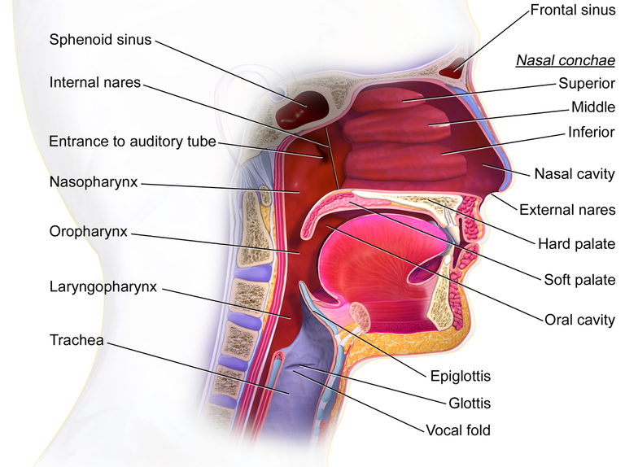
Upper Airway Complex

Slide 3
Spatial vs Time Resolution: Speech MRI
Lingala, Sajan Goud, et al. "Recommendations for real‐time speech MRI." Journal of Magnetic Resonance Imaging 43.1 (2016): 28-44.

Slide 4
Dynamic speech MRI
3 T
1.5 T
0.55 T

Slide 5
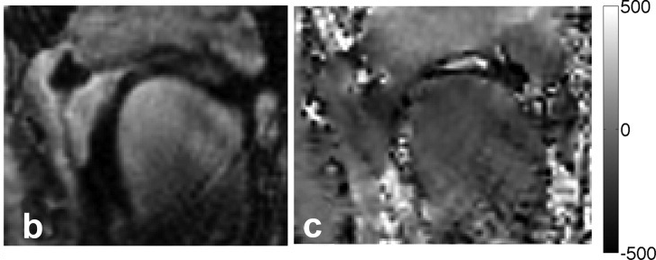
Dynamic speech MRI
3 T
1.5 T
0.55 T
Image
Field map
Sutton, Bradley P., et al. "Faster dynamic imaging of speech with field inhomogeneity corrected spiral fast low angle shot (FLASH) at 3 T."

Slide 6
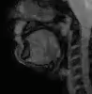
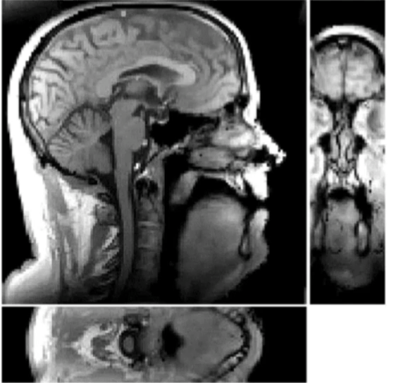
Dynamic speech MRI
3 T
1.5 T
0.55 T
Radial readouts (<1.2 ms)
Spiral navigators
Cartesian readouts (<1.2 ms)
2D dMRI
3D dMRI
Burdumy, JMRI 2016
Jin et al, MRM 2024

Slide 7
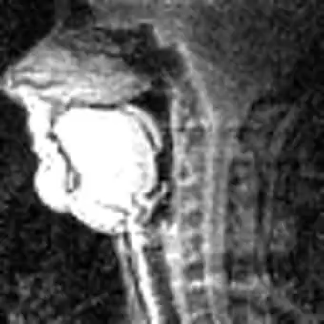
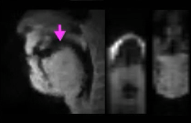
Dynamic speech MRI
3 T
1.5 T
0.55 T
Radial readouts (<1.2 ms)
Spiral navigators
Cartesian readouts (<1.2 ms)
Spiral readouts (<2.4 ms)
2D dMRI
2D dMRI
3D dMRI
Burdumy, JMRI 2016
3D dMRI
Jin et al, MRM 2024
Lingala et al, MRM 2016
Zhao et al, MRM 2021

Slide 8
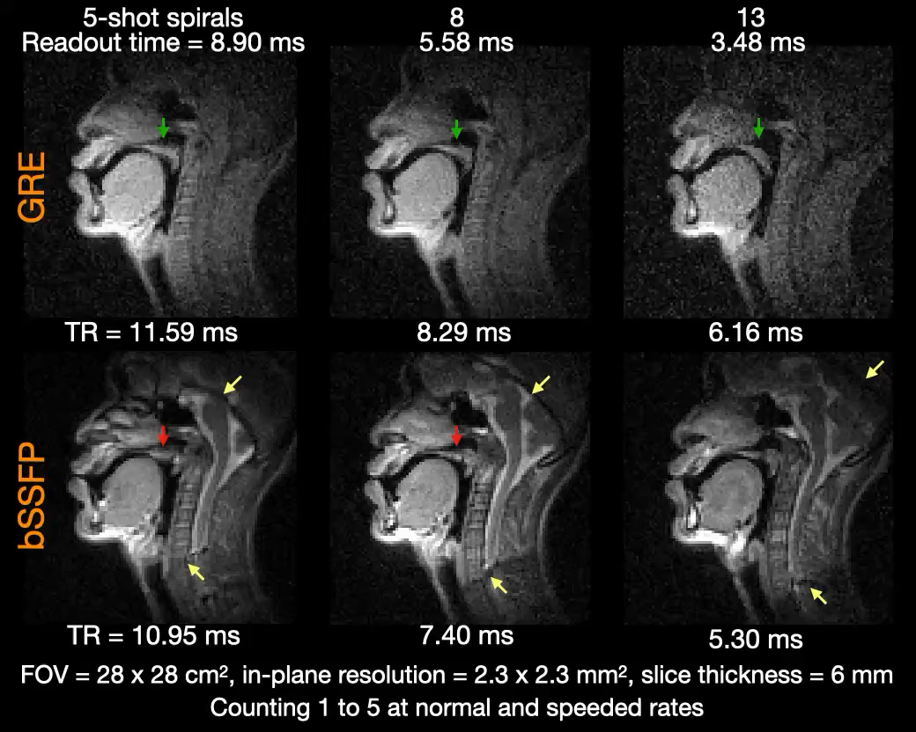
Dynamic speech MRI
3 T
1.5 T
0.55 T
Radial readouts (<1.2 ms)
Spiral navigators
Cartesian readouts (<1.2 ms)
Spiral readouts (<2.4 ms)
8.9 ms spiral readouts
2D dMRI
GRE
2D dMRI
3D dMRI
5.3 ms spiral readouts
Burdumy, JMRI 2016
3D dMRI
bSSFP
Jin et al, MRM 2024
Lingala et al, MRM 2016
Zhao et al, MRM 2021

Slide 9
To assess whether dynamic speech MRI can be achieved at 0.55 T using commercial gradients (Siemens Free max)
Purpose

Slide 10
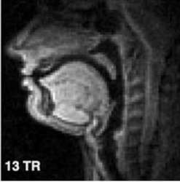
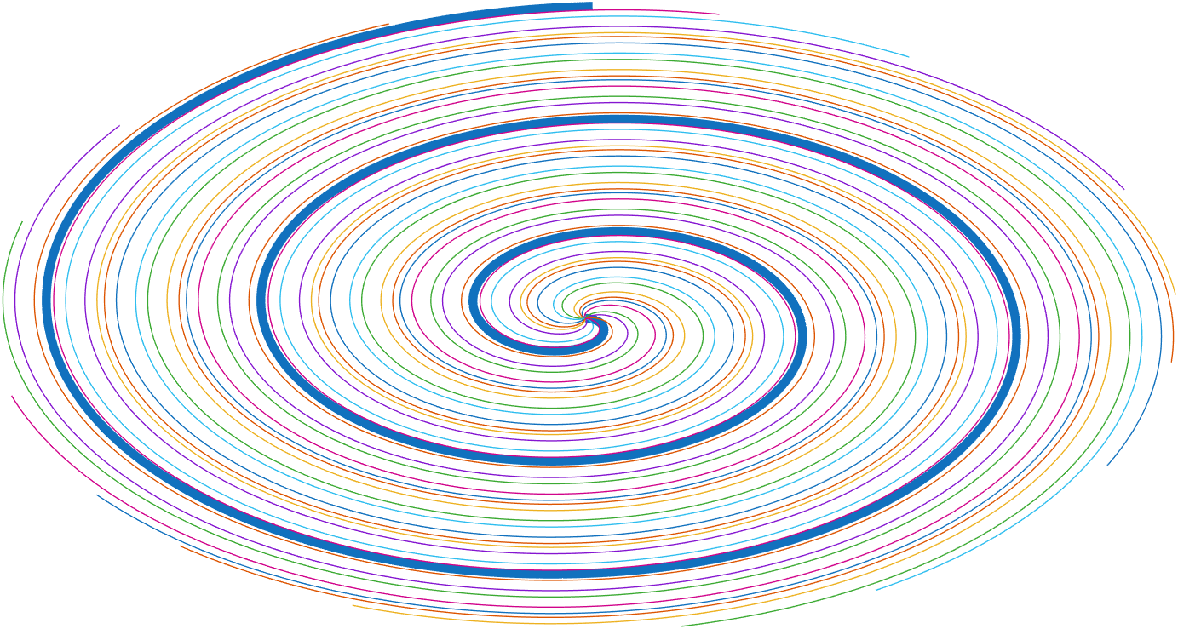
Goal: To design multi shot spirals
2.2 mm x 2.2mm
16 arms for full sampling
Velum
lips
Tongue
20 cm
epiglottis
glottis
20 cm

Slide 11
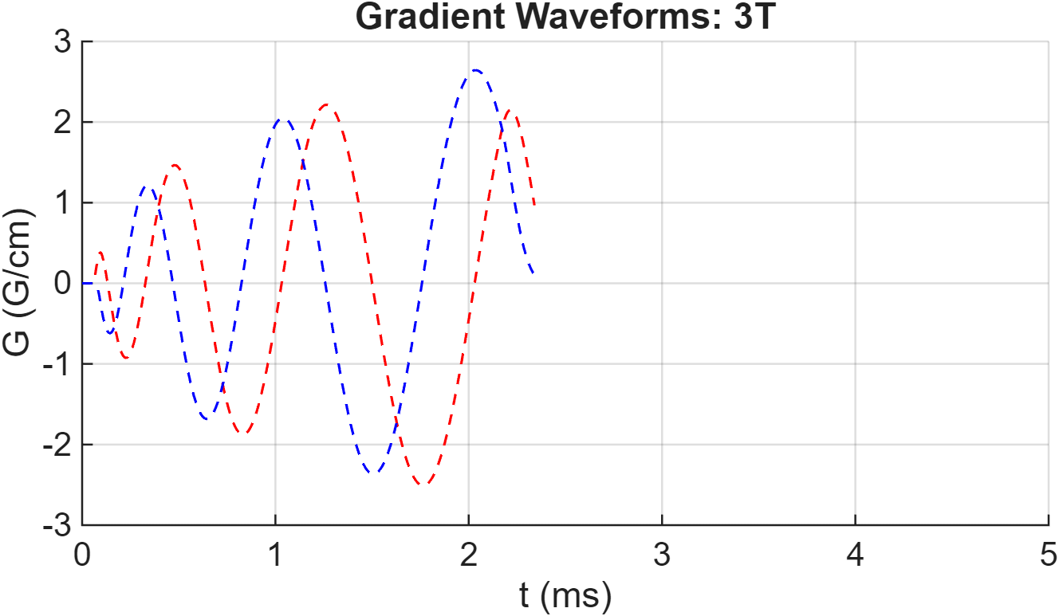
Implementation with varying gradient specifications
High performance Gradients
Slew rate= 150 T/m/s , Gmax = 80 mT/m, t_{read} = 2.3 ms
Example gradient waveforms for 16 spiral arms

Slide 12
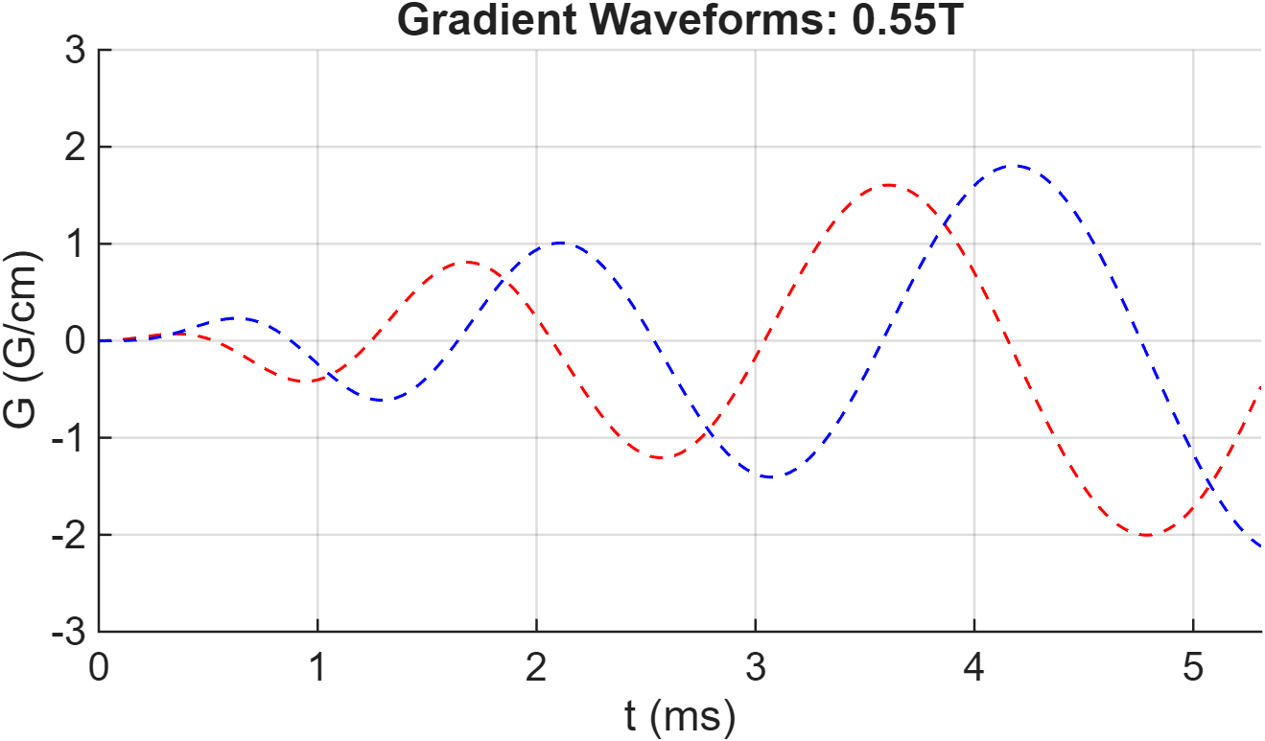
Implementation with varying gradient specifications
High performance Gradients
Commercial Gradients
Slew rate= 150 T/m/s , Gmax = 80 mT/m, t_{read} = 2.3 ms
Slew rate= 30 T/m/s , Gmax = 12 mT/m, t_{read} = 5.3 ms
Example gradient waveforms for 16 spiral arms

Slide 13
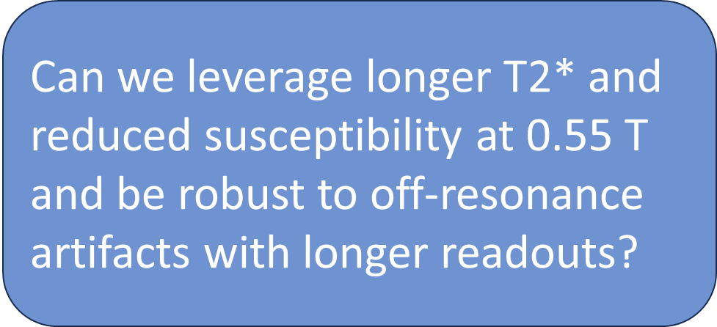
Implementation with varying gradient specifications
High performance Gradients
Commercial Gradients
Slew rate= 150 T/m/s , Gmax = 80 mT/m, t_{read} = 2.3 ms
Slew rate= 30 T/m/s , Gmax = 12 mT/m, t_{read} = 5.3 ms
Example gradient waveforms for 16 spiral arms

Slide 14
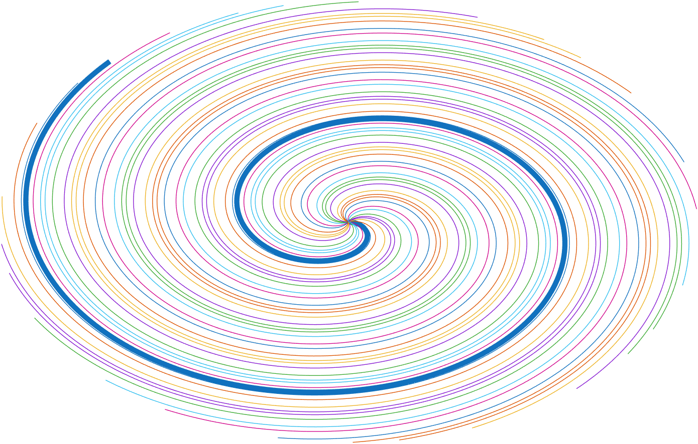
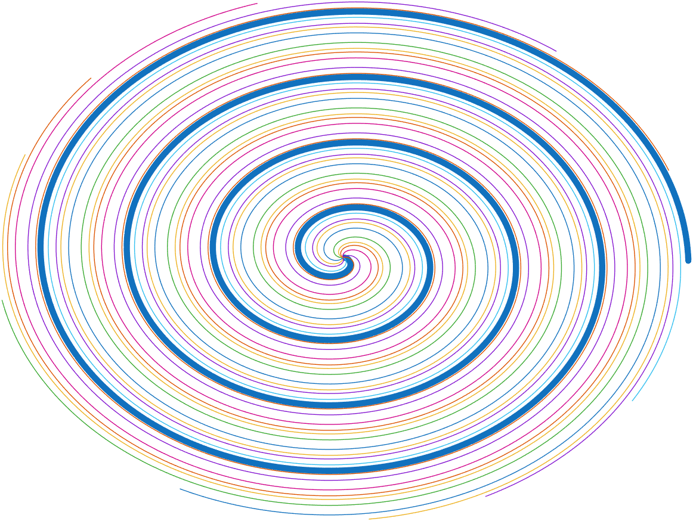
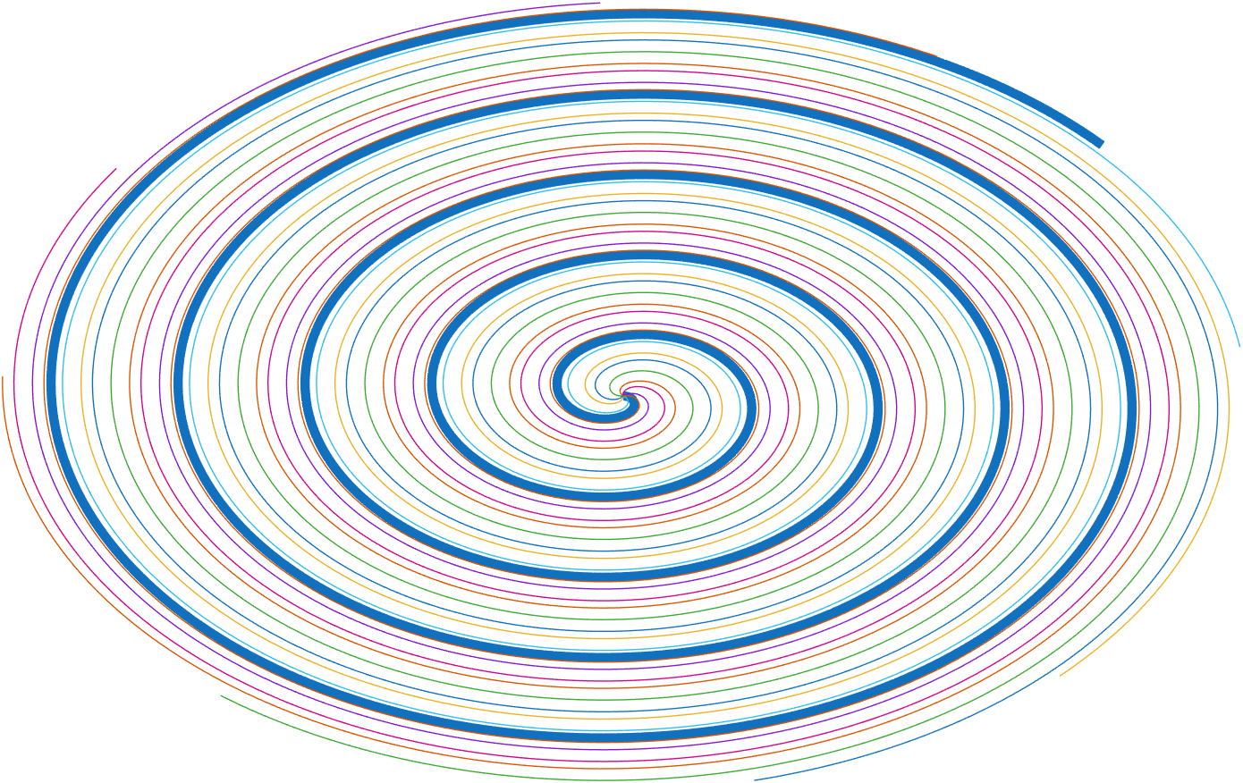
Uniform-density spirals implemented at 0.55T and 3T
Number of spiral arms for full sampling | 27 | 16 | 11 | 9
3 Tesla (Slew rate = 150 T/m/s, Gmax = 80 mT/m )
Readout duration (ms) | 1.48 | 2.344 | 3.308 | 3.992
TR (ms) | 6 | 6.5 | 7.5 | 8
Siemens FreeMax 0.55 T(Slew rate= 30 T/m/s , Gmax = 12 mT/m)
Readout duration (ms) | 3.588 | 5.32 | 7.38 | 8.89
TR (ms) | 7.1 | 9.1 | 12 | 14
FOV= 20 × 20 cm², resolution = 2.27 × 2.27 mm², slice thickness = 8 mm

Slide 15
Uniform-density spirals implemented at 0.55T and 3T
Number of spiral arms for full sampling | 27 | 16 | 11 | 9
GE Premier 3T(Slew rate = 150 T/m/s, Gmax = 80 mT/m )
Readout duration (ms) | 1.48 | 2.344 | 3.308 | 3.992
TR (ms) | 6 | 6.5 | 7.5 | 8
Siemens FreeMax 0.55 T(Slew rate= 30 T/m/s , Gmax = 12 mT/m)
Readout duration (ms) | 3.588 | 5.32 | 7.38 | 8.89
TR (ms) | 7.1 | 9.1 | 12 | 14
FOV= 20 × 20 cm², resolution = 2.27 × 2.27 mm², slice thickness = 8 mm

Slide 16
Experiments
2 volunteers were imaged
0.55 T (commercial gradients) and 3 T (high performing gradients)
Speech tasks: za-na-za (interleaved consonant vowel sounds) and fluent rapid speech counting numbers
Custom 16 channel coil utilized on the 3T
Flex 6 channel coil utilized on the 0.55 T
Continuous golden angle interleaving (mid-sagittal imaging)
View-sharing and spatio-temporal total variation reconstruction was implemented at varying under-sampling factors

Slide 17
Results

Slide 18

View-sharing reconstructions - subject uttering the phrase /za/-/na/-/za/
t_{read}=3.58 ms
27 arms | 16 arms | 11 arms | 9 arms
0.55T Free max
Slew rate= 30 T/m/s Gmax = 12 mT/m
t _{foot print}=191.7 ms
FOV= 20 × 20 cm², resolution = 2.27 × 2.27 mm², slice thickness = 8 mm
18

Slide 19



View-sharing reconstructions - subject uttering the phrase /za/-/na/-/za/
Robust to off-resonance blur at 0.55 T even at t_{read} = 8.89 ms
t_{read}=3.58 ms
t_{read}=5.32 ms
t_{read}=7.38 ms
t_{read}=8.89 ms
27 arms | 16 arms | 11 arms | 9 arms
0.55T Free max
Slew rate= 30 T/m/s Gmax = 12 mT/m
t _{foot print}=191.7 ms
t _{foot print}=145.6 ms
t _{foot print}=132 ms
t _{foot print}=126 ms
FOV= 20 × 20 cm², resolution = 2.27 × 2.27 mm², slice thickness = 8 mm
19

Slide 20

Robust to off-resonance blur at 0.55 T even at t_{read} = 8.89 ms
t_{read}=3.58 ms
t_{read}=5.32 ms
t_{read}=7.38 ms
t_{read}=8.89 ms
Number of spiral arms for full sampling
27 arms | 16 arms | 11 arms | 9 arms
0.55T Free max
Slew rate= 30 T/m/s Gmax = 12 mT/m
t _{foot print}=191.7 ms
t _{foot print}=145.6 ms
t _{foot print}=132 ms
t _{foot print}=126 ms
t_{read}=1.48 ms
3T
Slew rate = 150 T/m/s Gmax = 80 mT/m
t _{foot print}=162 ms
20

Slide 21



Robust to off-resonance blur at 0.55 T even at t_{read} = 8.89 ms
t_{read}=3.58 ms
t_{read}=5.32 ms
t_{read}=7.38 ms
t_{read}=8.89 ms
Number of spiral arms for full sampling
27 arms | 16 arms | 11 arms | 9 arms
0.55T Free max
Slew rate= 30 T/m/s Gmax = 12 mT/m
t _{foot print}=191.7 ms
t _{foot print}=145.6 ms
t _{foot print}=132 ms
t _{foot print}=126 ms
t_{read}=1.48 ms
t_{read}=2.48 ms
t_{read}=3.30 ms
t_{read}=3.99 ms
velum
blurred
velum
blurred
3T
Slew rate = 150 T/m/s Gmax = 80 mT/m
signal loss
tongue
dorsum
blurred
t _{foot print}=162 ms
t _{foot print}=104 ms
t _{foot print}=82.5 ms
t _{foot print}=72 ms
Pronounced off-resonance induced artifacts at 3T for t_{read} >1.48 ms
21

Slide 22
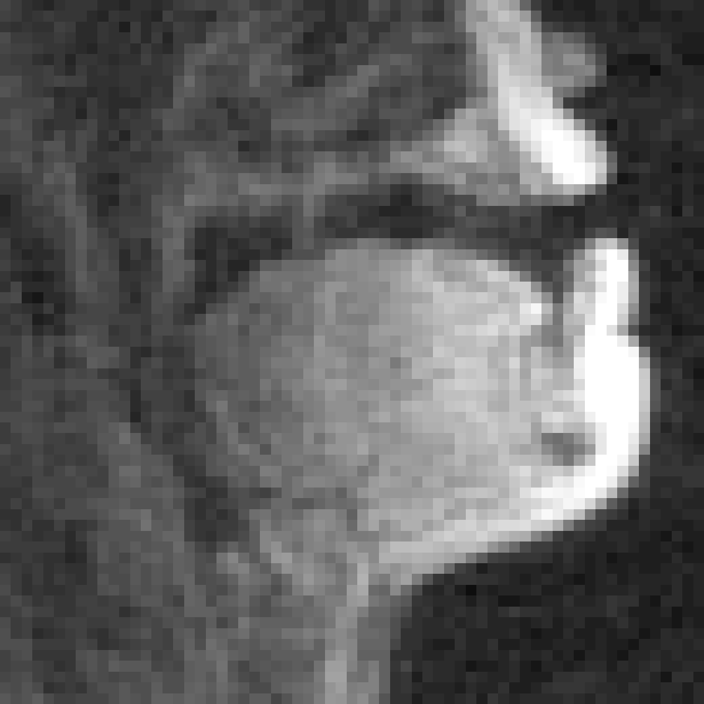
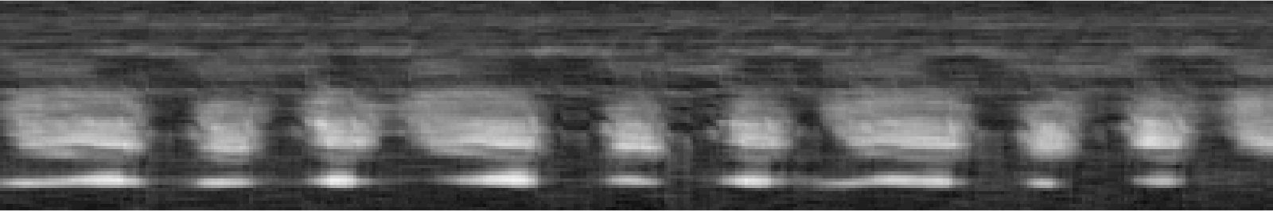
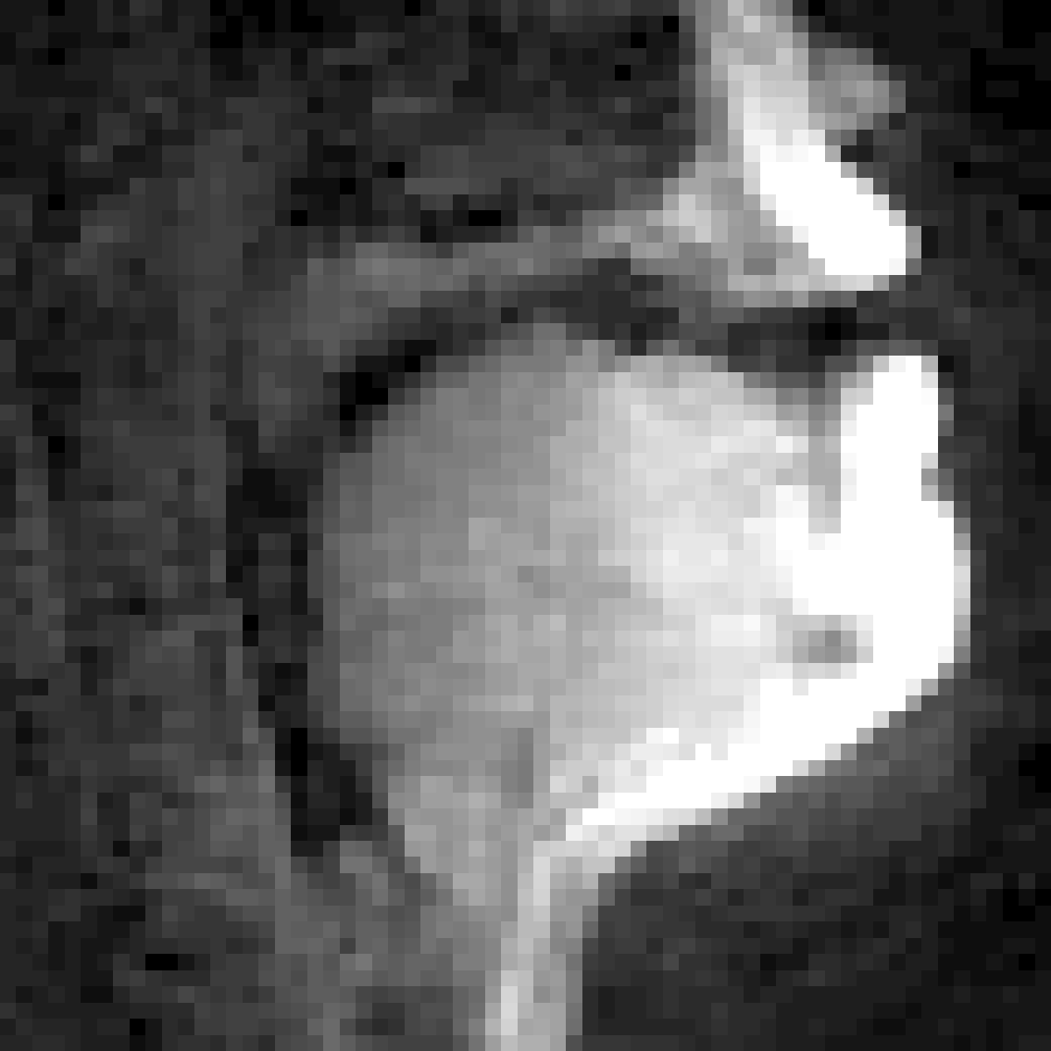
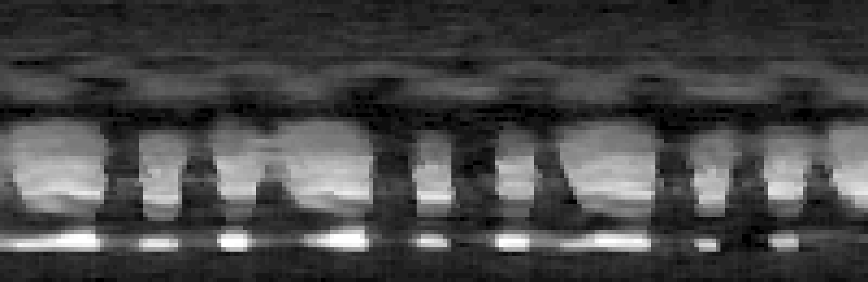

Comparing View Sharing and Constrained Reconstruction
t _{foot print}=145.6 ms
t _{foot print}=36.4 ms
velum
View sharing
tongue tip
Spatio temporal total variation reconstruction(rate 4)
lower lip
16 arms
Subtle motion blur with tongue tip and velum movements
Speech Task /za/na/za/
22

Slide 23

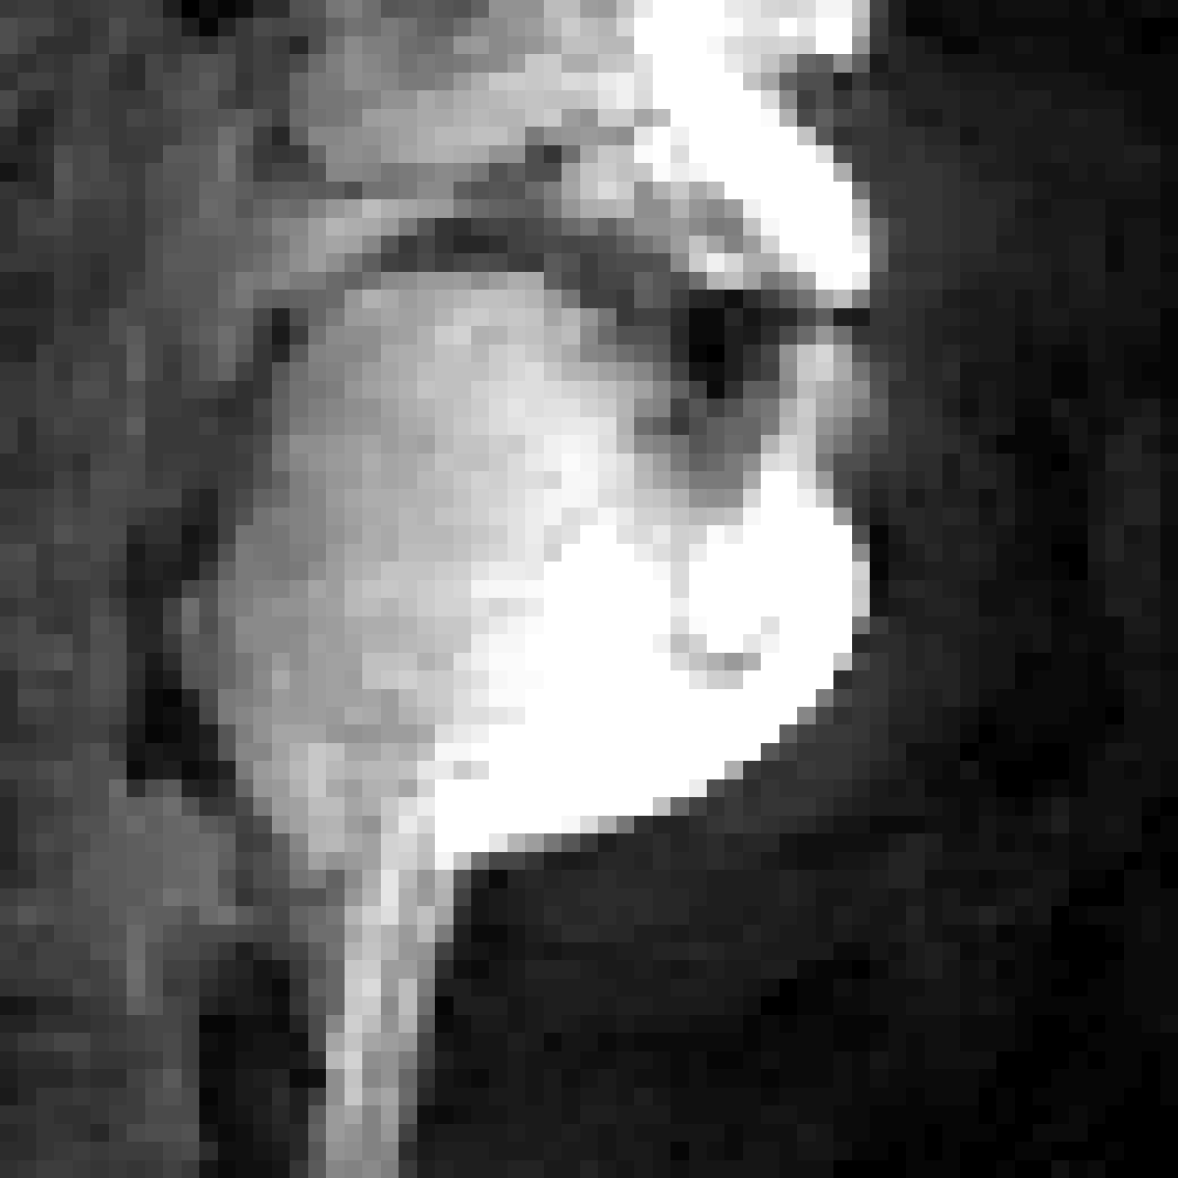
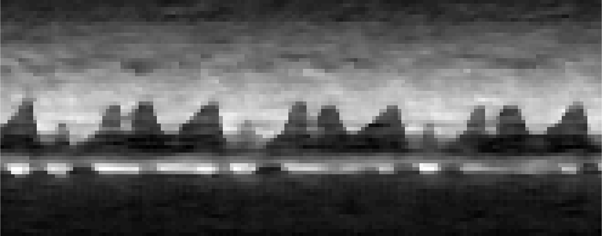
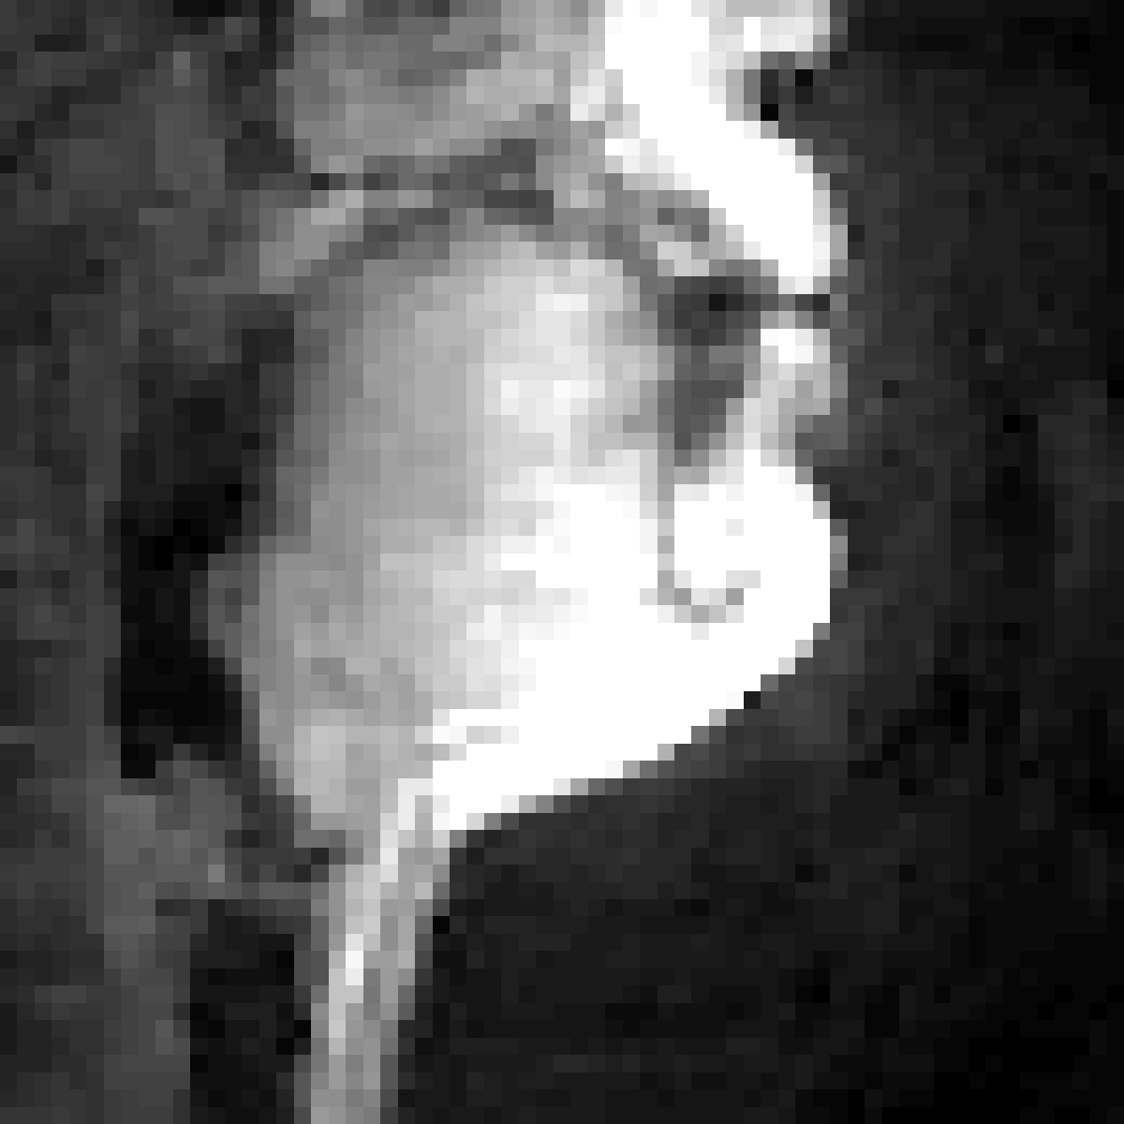
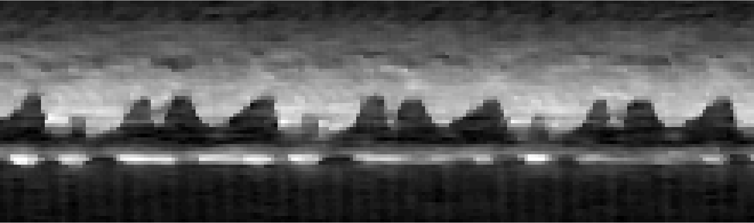
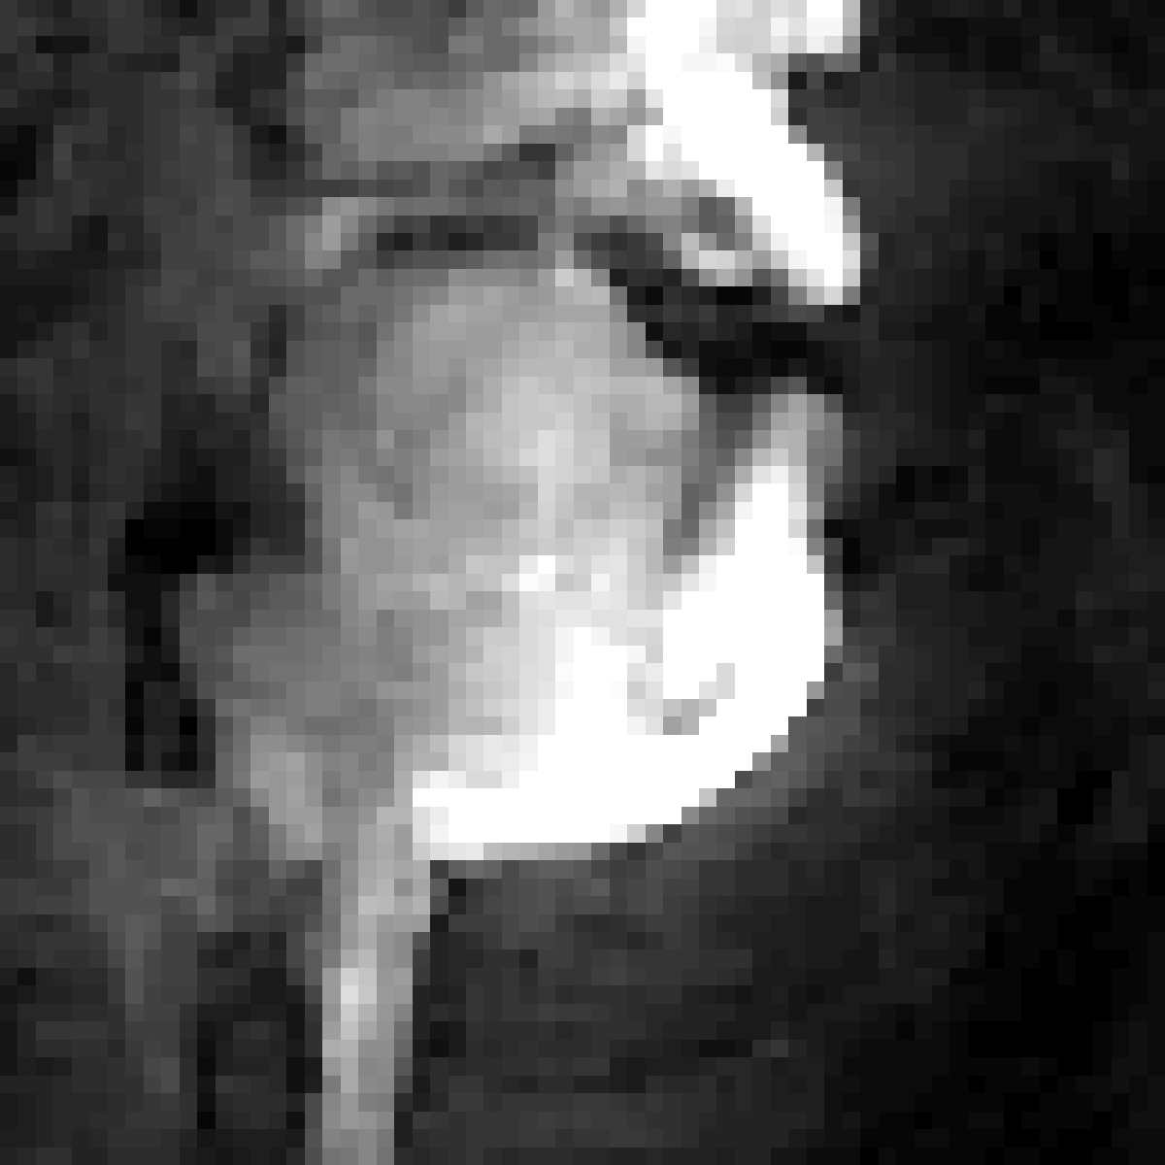
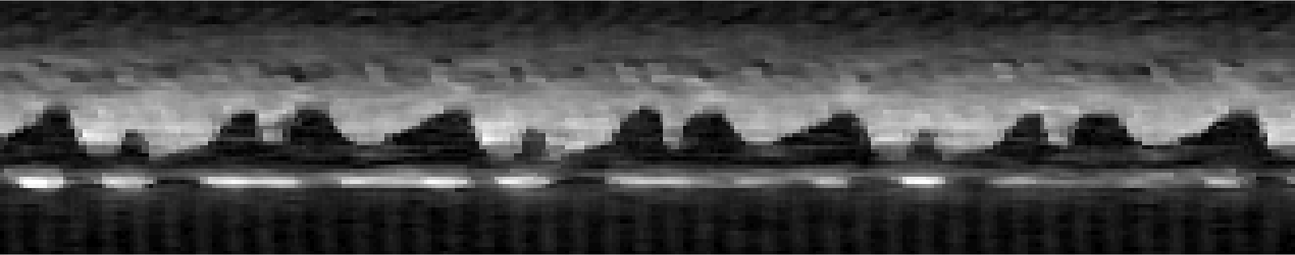
Constrained Reconstruction
t _{foot print}=36.4 ms
Dynamic images
Image time profile
Constrained reconstruction
(rate 4)
t _{foot print}=27.3 ms
rapid transitions blurred
Constrained reconstruction
(rate 6)
t _{foot print}=18.2 ms
faint alias artifacts
Constrained reconstruction
(rate 8)
sharper time profile
Speech Task rapid number counting
23

Slide 24
Conclusion
Off-resonance tolerance at low field permits extended spiral readouts with negligible signal loss upto a readout duration of ~9ms
Spatio-temporal TV constraint-based reconstruction provided temporal footprints up to 18–36ms.
This work
Free-Max 0.55 T
24

Slide 25
Acknowledgments
NIH NHLBI: R01 HL173483
NIH-S10 instrumentation grant: 1S10OD025025-01

